Slide 1
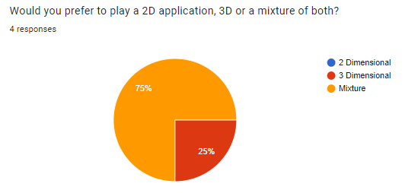
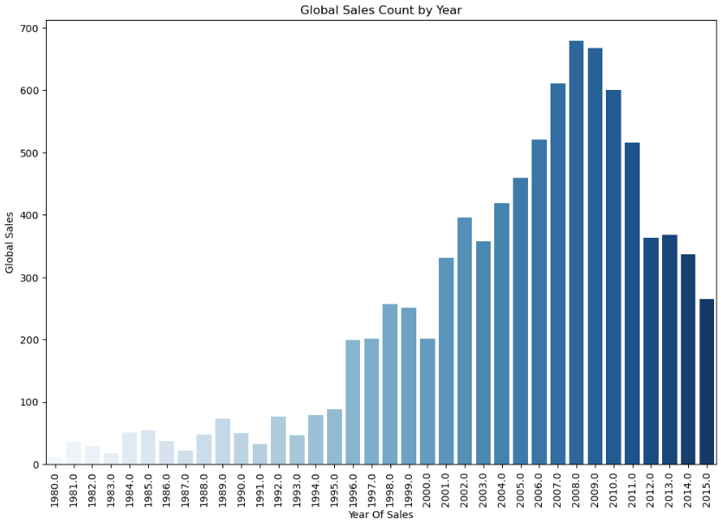
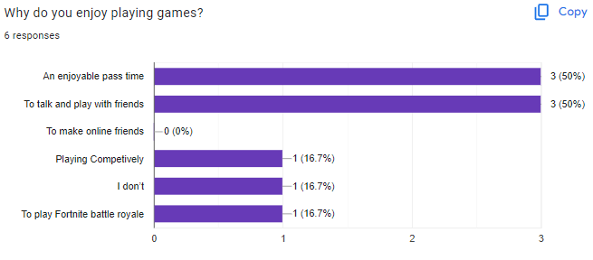
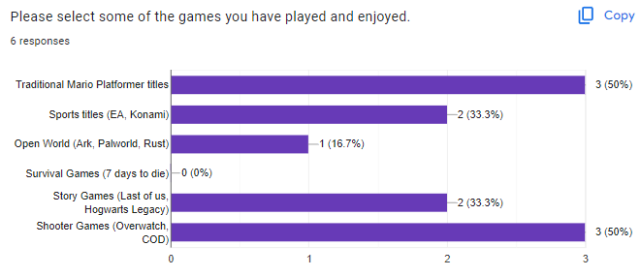
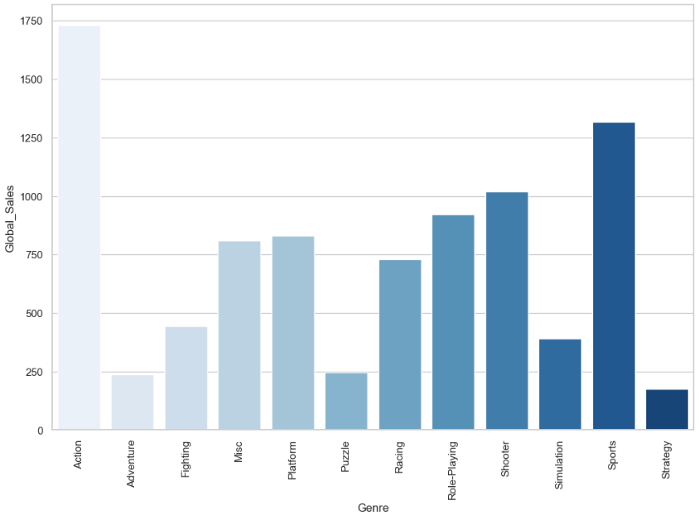
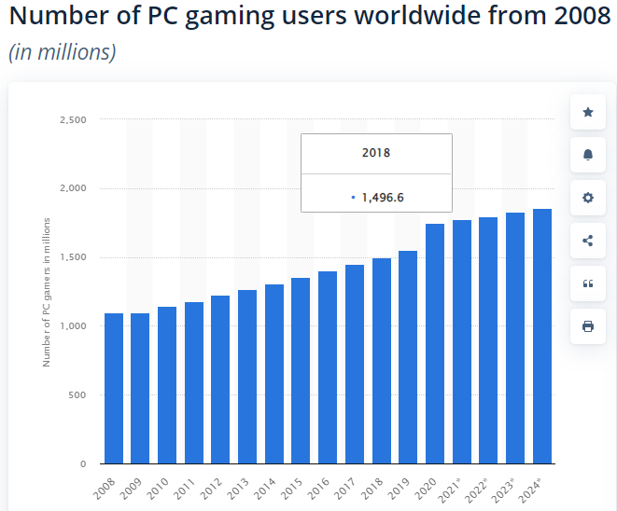
Creation of 3D/2D Platformer Multiplayer Games using Unity and Photon
Introduction
In the modern era, the prevalence of online gaming has reached unprecedented heights, engaging a staggering global community of 3.32 billion individuals who identify as 'gamers.' This diverse array actively participates in a myriad of gaming genres, spanning from immersive Virtual Reality (VR) experiences that involve virtual headsets to conventional 2D platformers like the iconic Mario series, which holds enduring appeal.
My study delves into the development of a gaming project that draws inspiration from these revered classics while strategically integrating modern elements, notably 3D implementation and a networking infrastructure facilitated by Photon's Network. This dissertation poster serves as a comprehensive guide on the ideas behind the incorporation of specific design choices and features within my developed game.
Aims
The aims of this project would be to examine the different trends causing the population strike of 2D and 3D games in recent years, and the features behind the increase. The aim of the project is to create something similar to the traditional SNES Platformer games, with implemented multiplayer to add a modern touch to classics.
Popular Genres – Inspiration
The figure below displays the number of Global sales per year, showing a steep increase after the 2000’s hit, where gaming became more mainstream and popular. I have decided to investigate games released within the time and platformers with aspects 2D/3D games were released, which is something I have chosen to implement into my project.
Some popular genres from the early 2000’s are listed below, which provided me with the inspiration I needed to begin development of my own application.
With Action and platformer both being extremely prominent entities within this field, I decided to implement these two genres and their features into my application. Research Objectives
Whilst researching for this dissertation project I aim to successfully integrate a multiplayer environment into my application, allowing for players to come together over a network. Aswell as this, for the player to enjoy and experience different features to the max, I have development plans to implement both 3D and 2D aspects within my application, meaning that players can move in both 2 and 3 dimensional aspects when interacting with others.
Development Methodology
When looking into the networking aspects of this project, I opted to use the Photon libraries to host and connect players to a server. Photon stands out as a versatile networking framework, streamlining the development process for multiplayer games. This choice aligns with the imperative need for efficient room creation, smooth player join/leave transitions, and synchronization of player actions across networks—critical elements in the development of engaging multiplayer titles.
Photon Features
The Photon API offers robust support for essential multiplayer functionalities, including room management, player connectivity, and seamless synchronization across diverse networks. Notably, it incorporates techniques to minimize latency, ensuring a responsive and immersive multiplayer experience for players.
Technical Components
My selected game architecture seamlessly integrates both 2D and 3D elements, providing players with a dynamic and engaging experience. In this design, players navigate through a series of challenges presented in a 2D platformer style across diverse levels. However, the innovation lies in the transition to a 3D environment within the level selection, similar to the approach seen in Super Mario Wonder.
In some cases, players may encounter 3D puzzle levels, presenting challenges that are inherently difficult or impossible to create in a 2D setting. To facilitate these transitions and diverse gaming experiences, I implemented multiple scenes within the Unity environment. These scene changes are orchestrated seamlessly using a scene manager triggered by specific in-game actions.
This architectural choice not only enhances the variety and complexity of the game but also allows for a more immersive and challenging player experience. The combination of 2D platformer dynamics and the introduction of 3D elements, including puzzle-solving scenarios, contributes to the uniqueness and richness of the overall gaming environment.
Primary data sources are extremely important when it comes to game development as it would mean that developers can gain an idea of what to implement into their game to reach the target demographic successfully.
Challenges and Solutions
Results So Far
So far, I have been able to provide promising development results for my networked application. With the implementation of a successful multiplayer application, allowing for the creation and joining of specific rooms, with unique usernames, and chat features. This would allow for players to communicate with their friends. Aswell as this, basic 2D and 3D sprites have been curated with multiple character types, integrated into both a simple 2D and 3D environment.
  Figure 3 would display some primary data that I had collected over time during initial development and planning stages.
  This figure shows the fact that people prefer a mixture of dimensional aspects within games for a more enjoyable experience, which is what I have chosen to implement.
  Figure 4 is another piece of primary data source; this question was used to gather ideas on why people played games.
  This information informed me of how important of a factor of having and implementing multiplayer within a title is with 50% of responses being something surrounding this ideology.
  The surge in the gaming industry from 2001 to 2009 was propelled by the successful integration of multiplayer functionality.
  The adoption of multiplayer features played a pivotal role in broadening the appeal of gaming during that period.
  The multiplayer trend transformed gaming into a social activity, fostering a sense of community among players.
  This phenomenon aligns with the theme of the dissertation poster, which focuses on creating a multiplayer game in Unity.
  The dissertation aims to explore both the technical and social dimensions of multiplayer gaming.
  I have chosen to go for a platformer title as it is a familiar aspect that everyone enjoys as seen in the demographic on the right.
  The modernization of the game would assist in the further enjoyment of these classic titles, being multiplayer development.
  Action-Adventure: Thrilling narratives merged with intense gameplay.
  First-Person Shooter (FPS): Immersive experiences from the protagonist's perspective.
  Role-Playing Games (RPGs): Epic storytelling and character development.
  Sports Simulation: Realistic sporting experiences.
  Platformers: Classic 2D/3D games with engaging level design.
  Real-Time Strategy (RTS): Tactical gameplay in dynamic environments.
  Survival Horror: Heart-pounding experiences in eerie settings.
  Some of the challenges that I have faced so far would be the idea of the multiplayer session needing to continue or terminate when the players change scenes back to the level selection after completing levels, I am still figuring out an optimum solution to overcome this challenge, however, right now players are able to disconnect whilst transitioning to the next scene and given the option to join another room.
  Another challenge would be gamepad implementation, however, due to the solid increase in PC Players seen in the corresponding figure, this feature will not be used as much so may not require as much focus in future development stages.,
References
Why are platformers the main indie game choice : R/gamemaker - reddit. Available at: https://www.reddit.com/r/gamemaker/comments/j2kolc/why_are_platformers_the_main_indie_game_choice/ (Accessed: 30 January 2024).
Feedback Form for User Experience, Available at: https://docs.google.com/forms/d/e/1FAIpQLSczPEVDgY8YVQmT5GZxyTd9mcLJTc5ReOUfcGb6LKW0i0pxPA/viewform?usp=sf_link (Accessed: 29 January 2024).
Statista. (Year) Number of PC Gamers, Available at: https://www.statista.com/statistics/420621/number-of-pc-gamers/ (Accessed: 29 January 2024).
Degree programme
BSc Computer Science

